Slide 1
Lecture 9
Diode models & Rectifiers

Slide 2
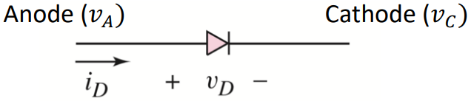
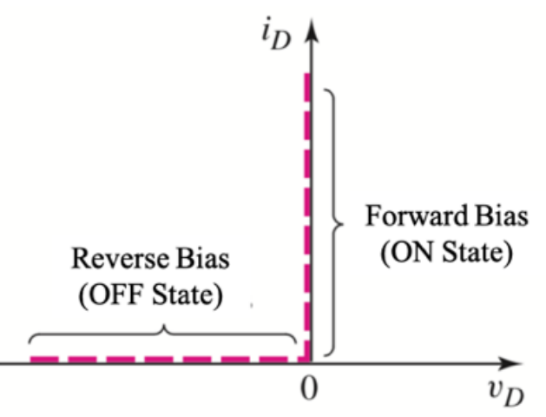
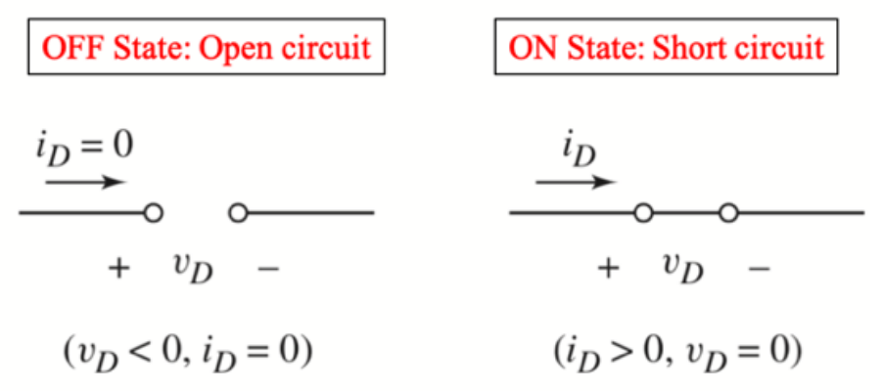
Review: Ideal Diode Model
From Microelectronics: Circuit Analysis and Design by Donald A. Neamen: Chapter 2. 4th edition. Published by the McGraw-Hill Companies, Inc. Used for educational purposes only.

Slide 3
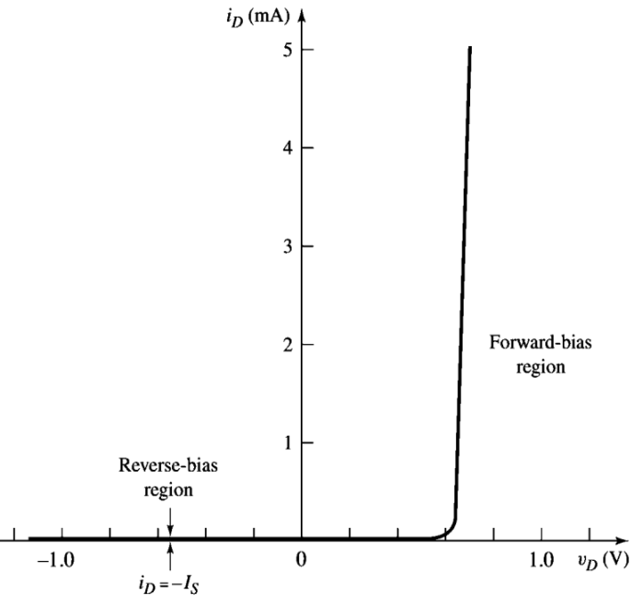
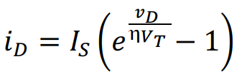
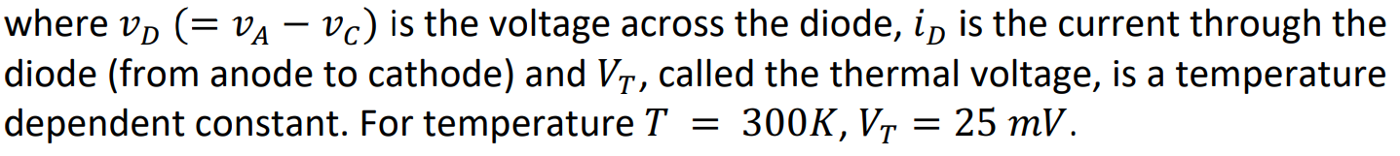
Real diode
Relation between diode current and diode voltage:
η is called the ideality factor (try to recall, you measured this in the lab!)
I-V characteristics of a real diode

Slide 4
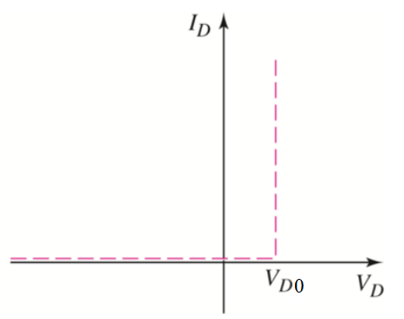
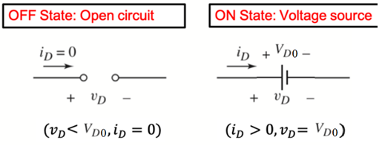
Modeling the real diode
1. Ideal diode model
2. Constant voltage drop (CVD) model
3. CVD+R model

Slide 5
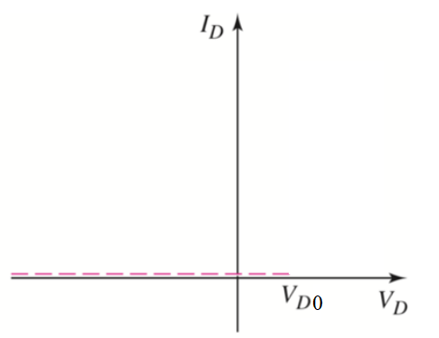
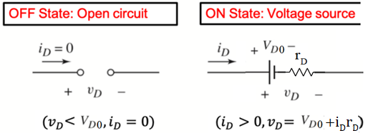
Modeling the real diode
1. Ideal diode model
2. Constant voltage drop (CVD) model
3. CVD+R model
1/slope = R

Slide 6
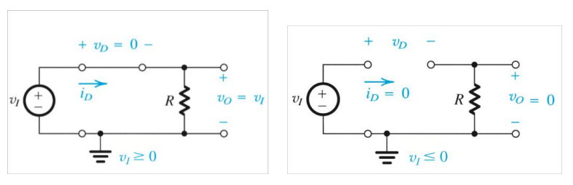
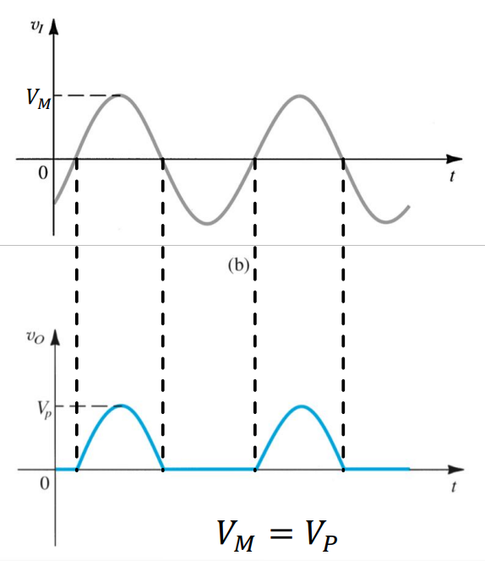
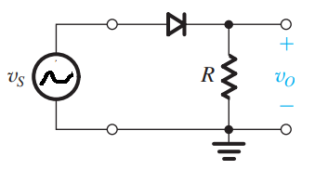
Half-wave rectifier (ideal diode model)
From Microelectronic Circuits by Adel S. Sedra & Kenneth C. Smith: Chapter 4. 7th edition. Published by Oxford University Press. Used for educational purposes only.

Slide 7
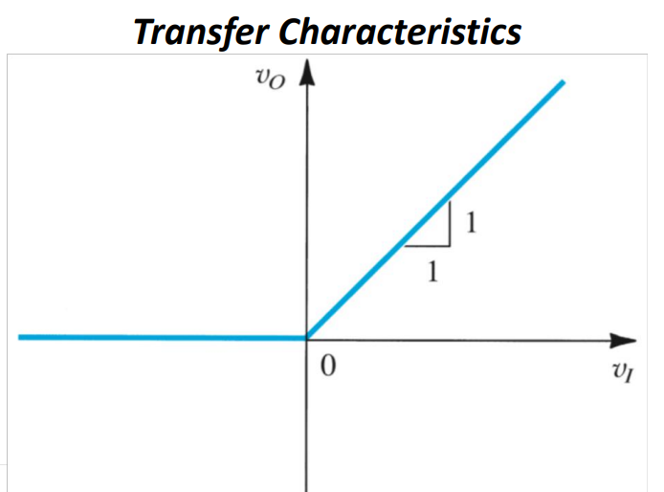
Half-wave rectifier (ideal diode model)
From Microelectronic Circuits by Adel S. Sedra & Kenneth C. Smith: Chapter 4. 7th edition. Published by Oxford University Press. Used for educational purposes only.

Slide 8
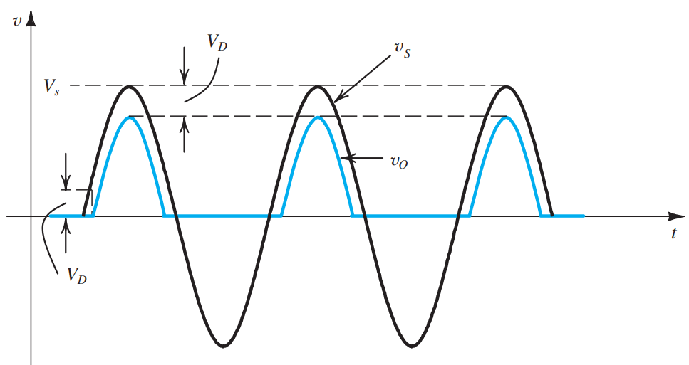
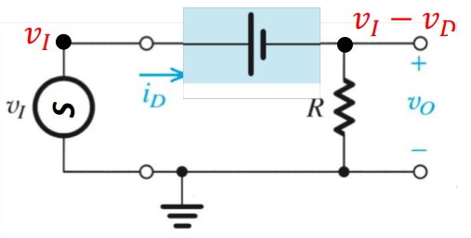
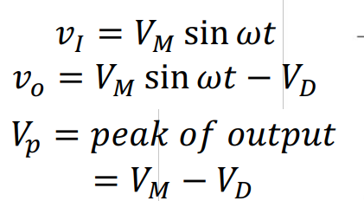
Half-wave rectifier (CVD model)
From Microelectronic Circuits by Adel S. Sedra & Kenneth C. Smith: Chapter 4. 7th edition. Published by Oxford University Press. Used for educational purposes only.

Slide 9
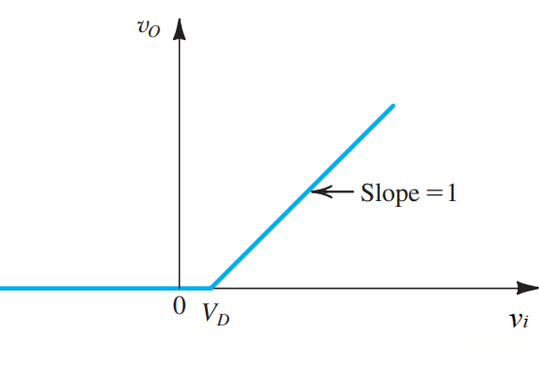
Half-wave rectifier (CVD model)
From Microelectronic Circuits by Adel S. Sedra & Kenneth C. Smith: Chapter 4. 7th edition. Published by Oxford University Press. Used for educational purposes only.

Slide 10
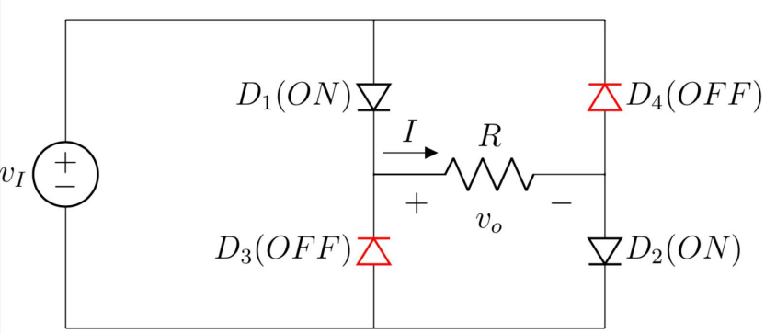
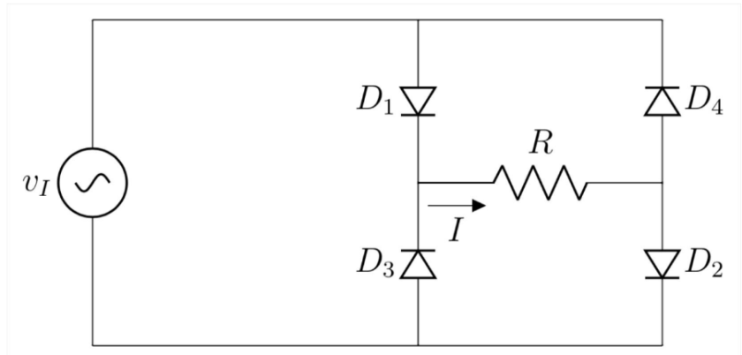
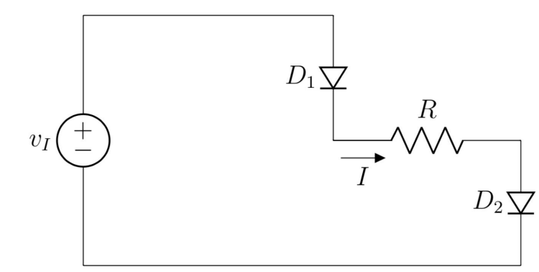

Full-wave rectifier (ideal diode & CVD model)
(+) half-cycle
From Microelectronic Circuits by Adel S. Sedra & Kenneth C. Smith: Chapter 4. 7th edition. Published by Oxford University Press. Used for educational purposes only.

Slide 11
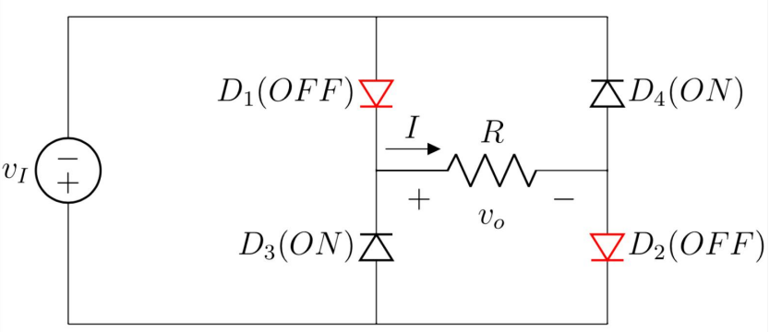
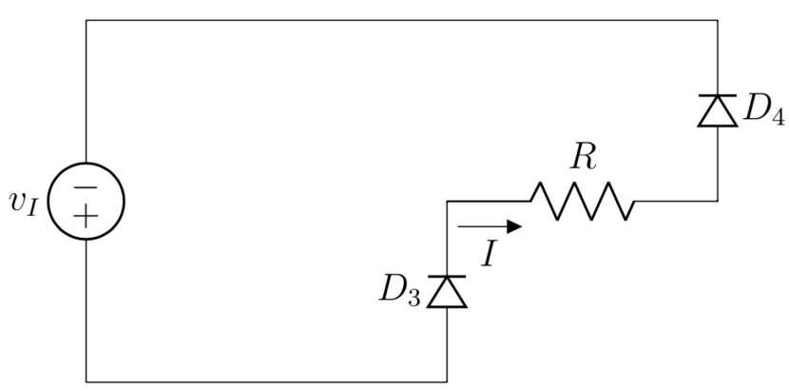
Full-wave rectifier (ideal diode & CVD model)
(-) half-cycle
From Microelectronic Circuits by Adel S. Sedra & Kenneth C. Smith: Chapter 4. 7th edition. Published by Oxford University Press. Used for educational purposes only.

Slide 12
Full-wave rectifier (ideal diode & CVD model)
From Microelectronic Circuits by Adel S. Sedra & Kenneth C. Smith: Chapter 4. 7th edition. Published by Oxford University Press. Used for educational purposes only.

Slide 13
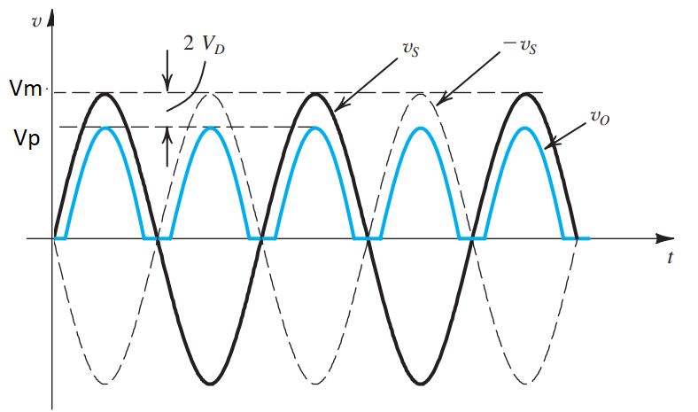
Full-wave rectifier (ideal diode & CVD model)
From Microelectronic Circuits by Adel S. Sedra & Kenneth C. Smith: Chapter 4. 7th edition. Published by Oxford University Press. Used for educational purposes only.

Slide 14

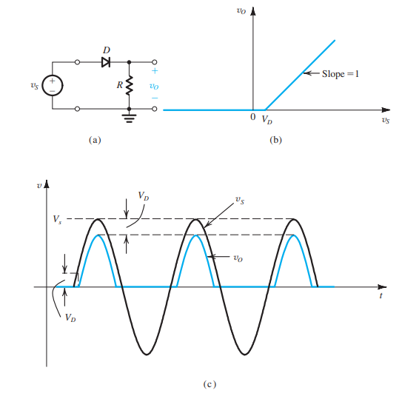
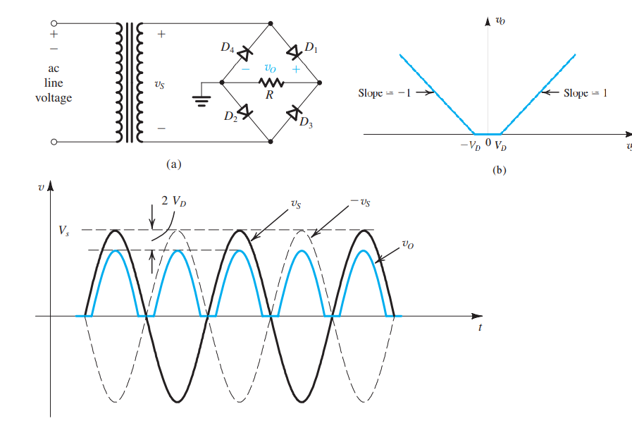
Half-wave and Full-wave rectifier
Half-wave
Full-wave
From Microelectronic Circuits by Adel S. Sedra & Kenneth C. Smith: Chapter 4. 7th edition. Published by Oxford University Press. Used for educational purposes only.

Slide 15
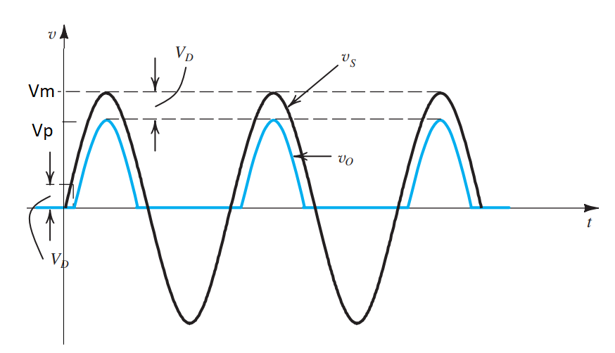
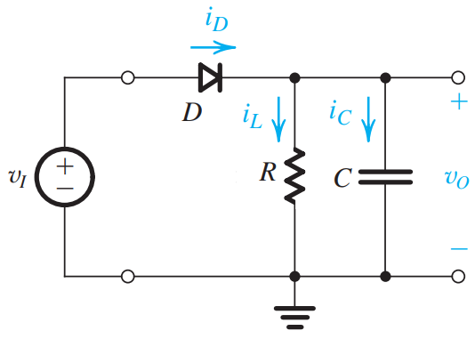
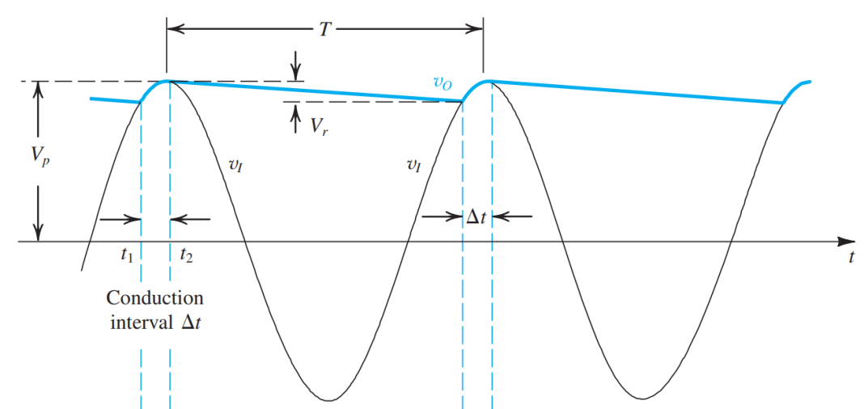
Filtering: Half-wave rectifier
From Microelectronic Circuits by Adel S. Sedra & Kenneth C. Smith: Chapter 4. 7th edition. Published by Oxford University Press. Used for educational purposes only.

Slide 16
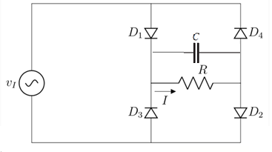
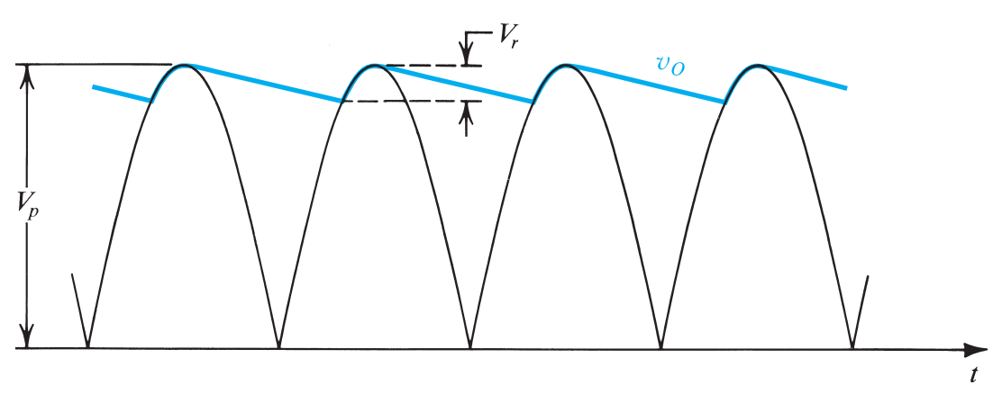
Filtering: Full-wave rectifier
From Microelectronic Circuits by Adel S. Sedra & Kenneth C. Smith: Chapter 4. 7th edition. Published by Oxford University Press. Used for educational purposes only.

Slide 17
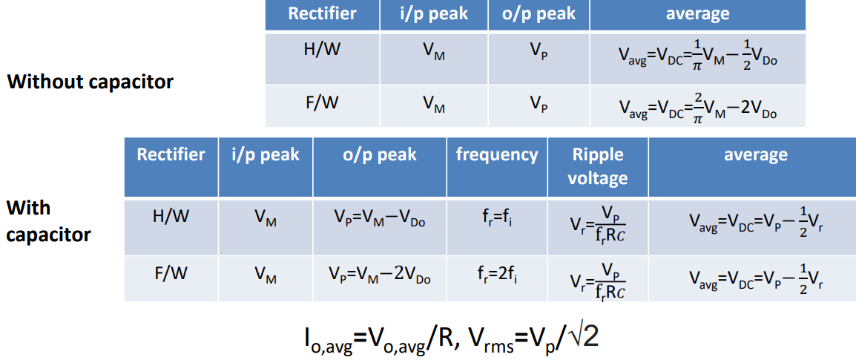

Slide 18
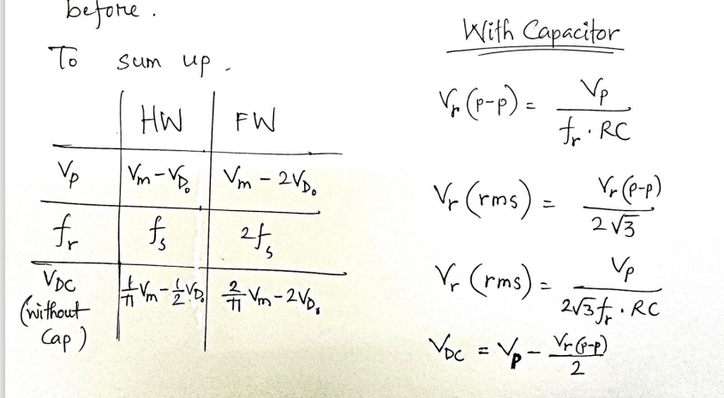

Slide 19

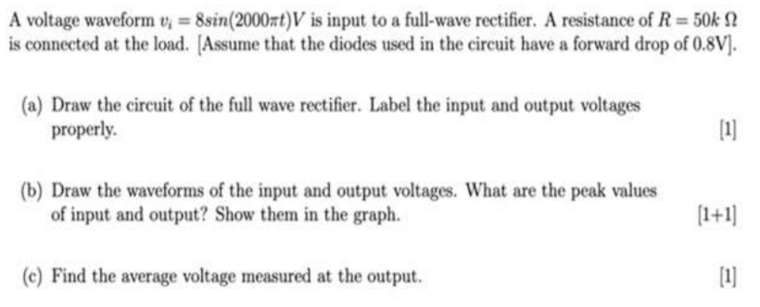
Example

Slide 20

Thank you

